Slide 1
WEB DESIGN
Chapter Five
Designing Effective Navigation

Slide 2
“Effective navigation will help your visitors to understand your site structure, to find what they need, and to explore everything your website has to offer.”

Slide 3
WHAT IS NAVIGATION?
Navigation is all about the links you provide to enable people to move between the different parts and pages of your website.

Slide 4
LAYING OUT YOUR NAVIGATION
You might think that every website looks different, but if you look closely, you’ll see that there’s often a lot of overlap in where navigation options are placed on websites.

Slide 5
GROUPING THE OPTIONS
Some people say that you should be able to get anywhere on the site within three clicks. Arranging links in easily understood groups helps to achieve that.

Slide 6
Before grouping
Books
CDS
Posters
Wallpapers
MP3’s
Who we are
Team Photos
Visiting Us
Contact us
After grouping
Shop
Books
CDS
Posters
Free downloads
    Wallpapers
    MP3’s
    About Us
    Who we are
    Team Photos
    Visiting Us
    Contact us

Slide 7
Have you seen a dropdown menu?
Dropdown navigation enables people to get to many more webpages in a single click, without clogging the screen up with too many links.

Slide 8




USING ICONS
Icons make it easy for people to see where they should click. There are a lot of symbols websites use like these…

Slide 9
THE ROLE OF THE HOMEPAGE
The homepage has a special role to play in your site’s navigation. As the page that people see when they type in your domain name, it’s the official first page of your website.

Slide 10
ENCOURAGING EXPLORATION
It’s essential to make it easier for people to find what they want, with clear navigation. But you should also inspire them to dig deeper, and try to explore the potential of your site. Sometimes, you can make this a playful feature of the navigation.

Slide 11
ADDING A SEARCH ENGINE
A search engine is an essential navigation feature. People don’t want to waste time navigating through your site. You can add a Google search engine to any website.

Slide 12
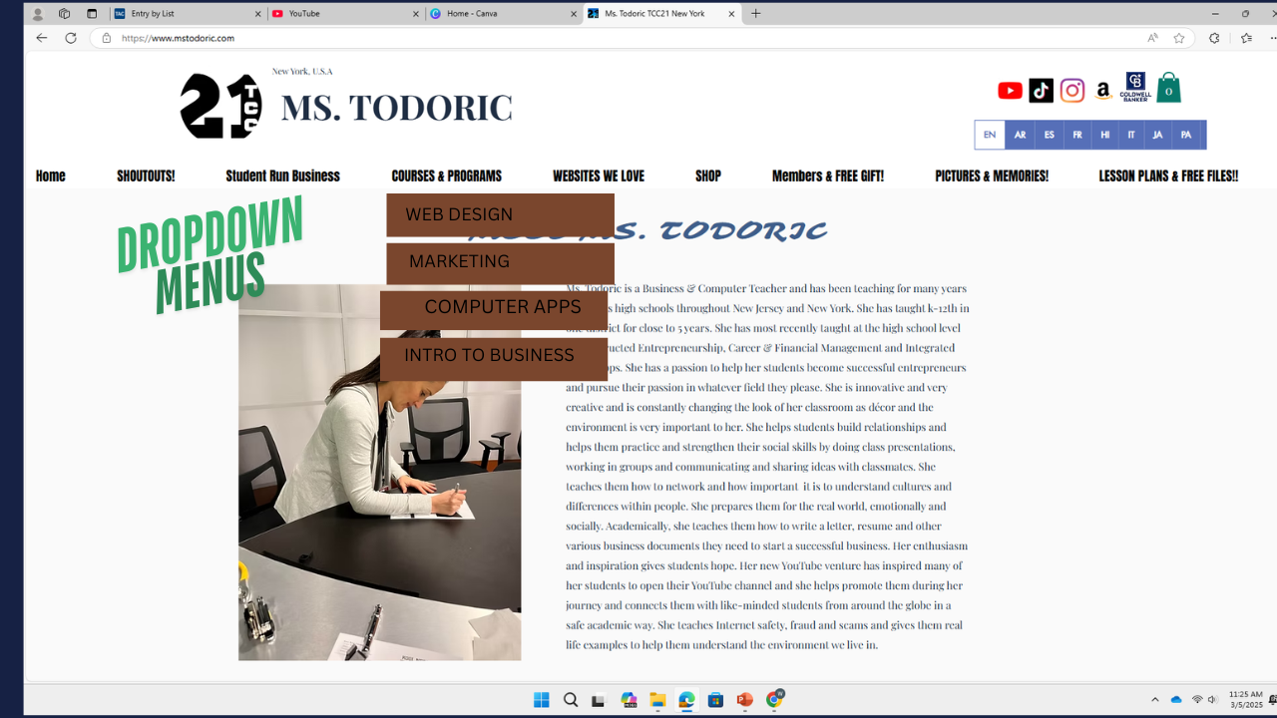
ASSIGNMENT
Using canva, create the home page of your website and include ONE drop down menu for your website.
Print this in color

Slide 13
SAMPLE

Slide 14

END OF CHAPTER 5

